Slide 1
Developing with .NET Core on AWS - what’s new
DEV318
Norm Johanson
Senior Software Developer
Amazon Web Services
Steve Roberts
Senior Technical Evangelist
Amazon Web Services

Slide 2
Session overview

Slide 3
.NET and .NET Core on AWS - latest news!
Bueller….?

Slide 4
Introducing our Simple Elastic Mosaic Processing Application
What does it do?
How was it built? What did we use?
What problems did we have to solve?
Demos, demos and more demos!

Slide 5
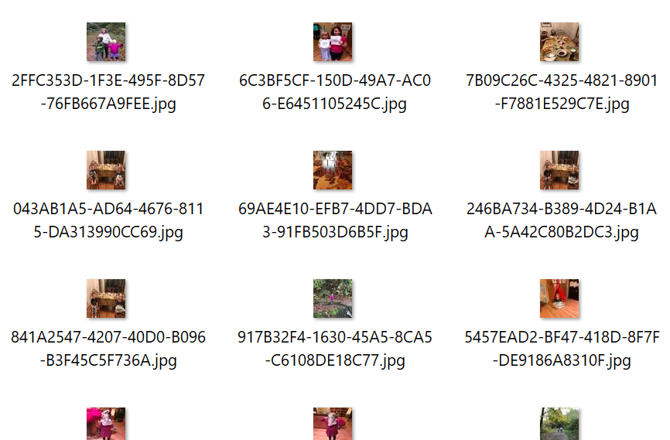

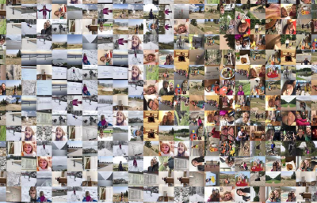

Example mosaic image
+
Tile Gallery

Slide 6
What are we going to learn?
Modern application architecture
Serverless and containers
Lambda debugging techniques
Using new AWS extension libraries in our application
CI/CD using the AWS Code services

Slide 7



Overall processing architecture
Application
Tile Data
Mosaic tile gallery
ingestion
Upload tile gallery images
Processed Tiles
Tile Gallery
Tiles
Upload image file
Mosaic rendering
Output mosaic

Slide 8
Mosaic tile gallery ingestion

Slide 9
What does tile ingestion do?
Accepts zip file from user containing multiple images
Analyzes each image to create tile information
Resizes each image and save as a tile in a named gallery

Slide 10







How tile ingestion works
Tile images (zip)
Image Moderation
Job Queue
Process Image
Image upload
Tile Color Data
Tile Storage
Container Image

Slide 11


Why did we choose AWS Batch?
Job Definition
Job Queue
Take advantage of Serverless
Manages the compute capacity for us
Work can be queued for asynchronous processing
Tile creation is not a time critical task
Gives us the option of lower cost using EC2 Spot Instances
Job 1
Job 2
…
Job N
Compute Environment
Spot Instance(s)
On-demand Instance(s)

Slide 12
Demo: tile ingestion

Slide 13
What did we learn?

Slide 14
Mosaic rendering

Slide 15
What does mosaic rendering do?
Accepts an image file from the user and name of a tile gallery
Analyzes the image against the tile data in the gallery
Builds mosaic image the matched tiles
We want different build processing based on image size
Suggests a workflow based approach

Slide 16


How mosaic rendering works
Input image
Tile Data
Output Mosaic
Trigger (API call or event)
Small Render
Subscribers
Map Colors
Select Tiles (F#)
Medium Render
Completion Notification
Large Render

Slide 17
Demo: mosaic rendering

Slide 18
What did we learn?

Slide 19
Web front-end

Slide 20
What does the web front-end do?
Allows an authenticated user to:
Upload zip of images for new tile galleries
Upload an image to create a mosaic

Slide 21


How the web front-end works
Web Server Clusters
Tile Import
Render Mosaic
Image file
User Pool
Container Image

Slide 22
Demo: hosting the web front-end

Slide 23
What did we learn?

Slide 24
Revisiting the architecture

Slide 25

Tile Gallery
Process Tile Image
Image Moderation
Job Queue
Web Front End
Image upload
Tile Color Data
Web Server Clusters
Parameter Store
Container Image
Tile Storage
Mosaic Rendering
Output Mosaic
User Pool
Container Image
Small
Map Colors
Select Tiles (F#)
Medium
Notify
Large

Slide 26
Session wrap

Slide 27
Useful links
TBD

Slide 28
Norm Johanson
@socketnorm
Steve Roberts
@bellevuesteve

